Slide 1
Traveling on University Business
August 20, 2025

Slide 2


Presenter: Emily Stoffel
Regional Travel Manager
Emily.Stoffel@wisconsin.edu
Topics:
Authorizations
Paying for Travel
Travel Agencies
Airfare
Hotel
Car Rental
Ground Transport
Meal Per Diems
Per Diem Calculator
Concur Walkthrough
Resources

Slide 3
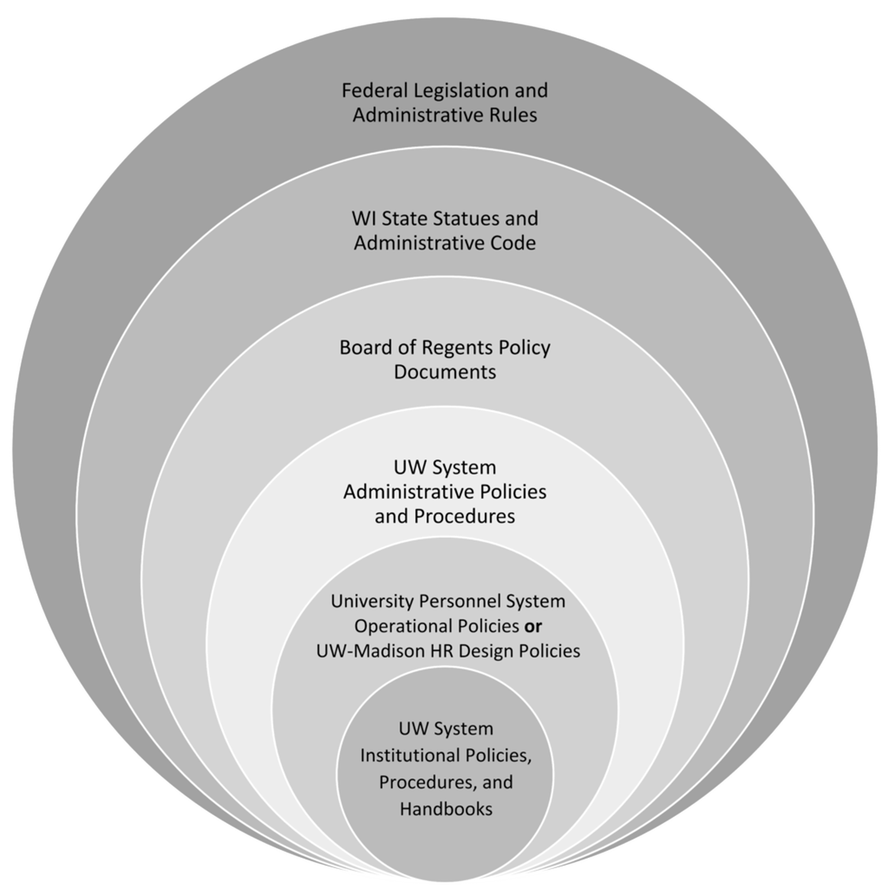
The more restrictive policy takes precedence
Always check with your supervisor/dept for specific travel policies

Slide 4
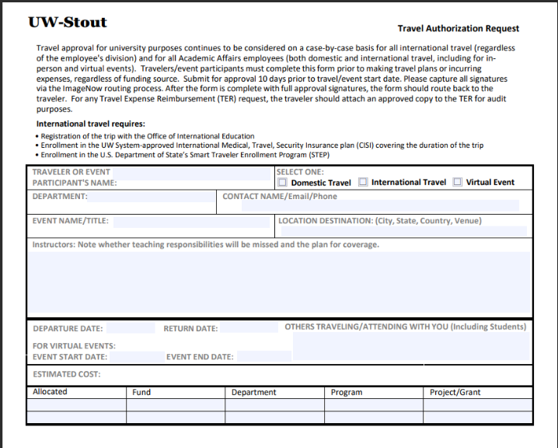
Travel Authorizations required for:
All international travel
All Academic Affairs employees’ domestic travel
All Academic Affairs employees attending virtual events even if no costs are incurred

Slide 5
Paying for Travel
Personal Funds
Shared Liability Card
Purchasing Card
Travel is allowed on P-Cards
University-issued credit card
Automatically paid
Reconciled within 60 days via expense report in Workday
Personal funds may always be used to pay for travel
Reimbursement is done through an expense report in Workday
Formerly Corporate Card
University-issued liability credit card only for travel = cardholder’s responsibility to pay within 60 days, or late fees are assessed
Card is paid via expense report in Workday

Slide 6
Receipt requirements when paid with…
Purchasing Card
Personal Funds or Shared Liability Card
Receipts required for every purchase
Do not use Pcard for meals included in the per diem or gas when using a personal vehicle
Receipts are required for purchases over $50
Receipts are not required for mileage or per diem reimbursements

Slide 7




Travel Agencies
Most university travel MUST be booked using the approved travel agency
Fox World Travel = individual travel; work with a travel agent
  $31.50 service fee per domestic airline ticket
  $41.50 service fee per international airline ticket
  No Service fees for hotel or car only reservations
  Recommended for complex international bookings, same-day travel, etc.
Fox World Travel = group travel (10 or more tickets)
Concur = online booking tool
  All employees have a Concur profile
  Name in Concur is from Workday; ensure LEGAL name is correct and complete to match ID’s used for travel
  $6.00 service fee per airline ticket (domestic or international)
  No Service fees for hotel or car only reservations
Shorts Travel = athletics
Fox World Portal = invoices and forms

Slide 8

Airfare
Must ALWAYS be booked with a travel agency or in Concur
CANNOT be booked on third-party website (Expedia, Travelocity, etc.) or directly with airlines
Seat assignment fees are allowed but cannot be for cabin upgrades/class change
Allow baggage fees
Valid cost comparisons are required when:
  Adding personal stops to trip (ex., Conference in Denver but flying from MSP to DEN to San Diego for personal reasons and back to MSP)
  Layovers longer than one night
  Departing from/returning to airport outside of WI or more than 100 mi from the WI border for personal reasons (including from voluntary remote work location)

Slide 9

Lodging
Reimbursement is allowed up to maximum nightly rate for location
  Per Diem Calculator shows rates
  If city is not listed, use county
  Exceptions to nightly max:
    Designated conference hotels
    Overaged due to taxes and fees (not applicable in WI)
    No hotels available under max rate (proof required)
Can book in Concur, with travel agency, or direct with hotel
Tax Exemption
  Always tax exempt in WI
  Other states have some tax exemption.
  Check TravelWIse for list
NEVER book with a third party site (booking.com, Expedia, etc.)… you will NOT be reimbursed & BEWARE OF SCAMS

Slide 10




Ground Transport
Fleet Vehicles
103 General Services Building
715-232-2200
vehiclef@uwstout.edu
Driver Authorizations
Required for all drivers on university business
Must be completed prior to travel
Required for rental vehicles, personal vehicles, fleet vehicles
Options
Rental vehicles
Fleet vehicles
Personal vehicles
Safety & Risk Management
715-232-1793

Slide 11



Rental Vehicles
Must utilize Enterprise/National or Hertz contracts
Book in Concur or directly with vendor (must ensure contract is applied)
Use rentals when it is the most cost-effective means of transport
Rent Compact/Standard/Intermediate vehicle classes
UW reimburses cost of rental vehicle and gas
Do NOT take any add-on services
Personal booking codes can be found on TravelWIse

Slide 12

Personal Vehicles
Fleet Vehicles
Fleet vehicles are encouraged for all employees
Managed by Facilities Management
Not entered into reimbursement system
Mileage is entered into the reimbursement system at the Standard rate $0.70/mile
Turndown rate is no longer utilized
Workday expense reports calculate mileage automatically based on location information
Maps and receipts do not need to be included for reimbursement
Only mileage is reimbursable (ie. Gas is not reimbursed separately)

Slide 13

Meal and Incidental Per Diem
Per Diem rates
  Reimbursement paid directly to the employee AFTER travel
  Vary based on location and number of meals needed
  No longer deducting for first/last day; only deducting for meals provided
  Day Trip - $15 taxable
Incidentals are no longer calculated separately. If you claim all meals were provided, you will receive $0 for that day
Not recommended to pay for meals with Shared Liability Card; but, if you do, make sure to pay these card charges with personal funds
No receipts required for per diem
Per Diem Calculator

Slide 14
Per Diem Calculator

Slide 15
Concur Walkthrough

Slide 16
Resources
UW Stout Travel Page
UW System TravelWIse
Per Diem Calculator
Concur
Workday
Travel Manager Emily Stoffel
Emily.Stoffel@wisconsin.edu
608-263-1040
Employee Checklist
Ensure name on Concur account is correct
Apply for UW card product/s if desired
  Purchasing Card
  Shared Liability Card
Complete a driver authorization

